Slide 1



İŞLETİM SİSTEMLERİ
UYGULAMA-3

Slide 2
Section Outline
What is IPC
IPC standards
Posix IPC Methods
  Pipes
  Fifos
  Signals
  Semaphores
  Message queues
  Shared memory

Slide 3
What is IPC
Inter-process communication (IPC) is a set of methods for the exchange of data among multiple threads in one or more processes.
  Processes may be running on one or more computers connected by a network.
  IPC methods are divided into methods for message passing, synchronization,
shared memory, and remote procedure calls (RPC).

Slide 4
IPC Methods
Unix
System V
POSIX
Others
  Sockets
  Dbus
  So on…
Notes:
Unix IPC → simple stream-based communication (pipes, FIFOs, sockets, signals)
System V IPC → kernel-managed message queues, semaphores, shared memory with persistent keys
POSIX IPC → modern, standardized, portable replacements for System V, with cleaner APIs

Slide 5
POSIX IPC
Pipe
FIFO
Signals
Semaphores
Message Queues
Shared Memory
Notes:
Direct vs Indirect communication
Direct: processes know each other (send/receive)
Indirect: use mailbox, queue, FIFO
Blocking vs Non-blocking
E.g., blocking recv() waits until message arrives
Non-blocking queues return immediately or buffer

Slide 6
IPC Method | Best For | Not Good For
Pipes | Simple, one-way communication between parent/child; shell pipelines | Unrelated processes; bi-directional comm; structured messages
FIFO (Named Pipe) | Simple streaming between unrelated processes; command-line tools | High performance; message priority; data persistence
Signals | Notifications/events (stop, continue, child finished); async alerts | Sending data; complex synchronization
Message Queues | Message-based IPC with priorities; producer-consumer | Very large or high-throughput data
Shared Memory | Fastest data sharing; large buffers; real-time apps | Needs extra synchronization; no message structure
Memory-Mapped File | Shared access to files; persistent data; databases/caches | Frequent small messages; heavy write sync

Slide 7

Persistence of IPC Objects
process-persistent IPC:
  exists until last process with
  IPC object closes the object
kernel-persistent IPC
  exists until kernel reboots or
  IPC object is explicitly deleted
file-system-persistent IPC
  exists until IPC object is
  explicitly deleted
PROCESS
KERNEL
FILESYSTEM

Slide 8
IPC | Stored Where? | On Disk? | Visible in Filesystem? | Survives Reboot?
POSIX SHM (shm_open) | RAM (/dev/shm - tmpfs) | ❌ | ✅ | ❌
POSIX MQ (mq_open) | Kernel memory (/dev/mqueue) | ❌ | ✅ | ❌
POSIX Semaphores | Kernel memory (/dev/shm) | ❌ | ✅ | ❌
FIFO (mkfifo) | Disk (inode) | ✅ file only | ✅ | ✅ (file), not data
Pipes / unnamed shm | RAM | ❌ | ❌ | ❌

Slide 9
Concept | Key Idea | Example IPC Methods
Direct | Processes name each other | Pipes, Signals, Connected Sockets
Indirect | Use a mailbox/queue, not process names | Message Queues, Shared Memory Buffers
Blocking | Process waits | Blocking read() on pipe, mq_receive() with no messages
Non-Blocking | Process continues immediately | O_NONBLOCK on pipes/queues, non-blocking sockets

Slide 10
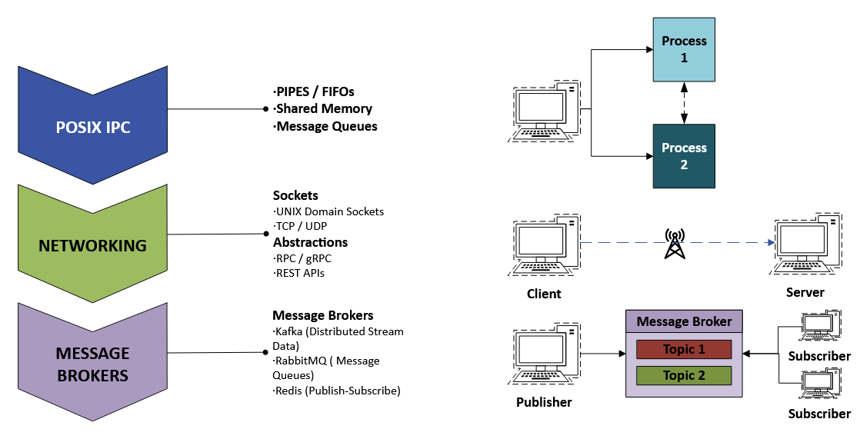
Progression of IPC Methods
Notes:
Message Brokers
“Sockets assume two processes talk directly. Message brokers decouple them, add reliability, persistence, and scale.”
Now communication can survive:
✔ crashes
✔ network delay
✔ offline components

Slide 11
Pipes
A pipe provides a one-way flow of data
  example: who | sort| lpr
The difference between a file and a pipe:
  pipe is a data structure in the kernel.
A pipe is created by using the pipe system call
  int pipe (int* filedes);
  Two file descriptors are returned
filedes[0] is open for reading
filedes[1] is open for writing
Typical size is 512 bytes (Minimum limit defined by POSIX)

Slide 12
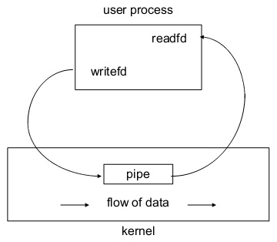
Pipe
(Single Process)

Slide 13
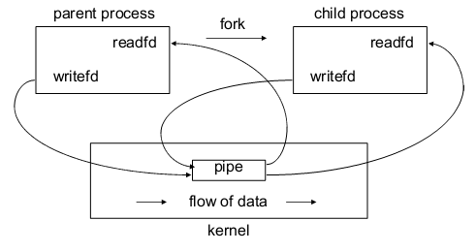
Pipe
(Two Process)
Just after fork

Slide 14
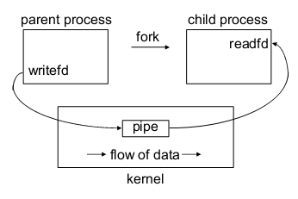
Pipe
(Two Process)
Parent opens file, child reads file
  parent closes
read end of pipe
  child closes write
end of pipe

Slide 15
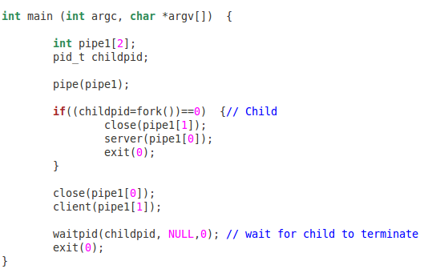
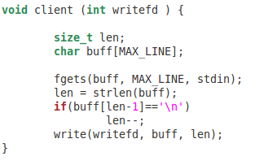
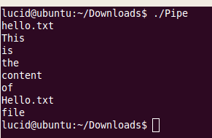
A simple pipe example
Ex_1_pipe.c

Slide 16
More on Pipes
FILE *popen (const char * command, const char *type)
  Type is r, the calling process reads the standart output of the command,
  Type is w, the calling process writes to the standart input of the command
  Return file * if OK, NULL on error
int pclose (FILE *stream);
  Closes a standard I/O stream that was created by popen

Slide 17
FIFOs
Pipes have no names, they can only be used between processes that have a parent process in common.
FIFO stands for first-in, first-out
Similar to a pipe, a unidirectional (semi-bidirectional) data flow is performed in terms of the functions used to write or read.
However, unlike a pipe in terms of its structure, bidirectional communication is possible.
A FIFO has a pathname associated with it, allowing unrelated processes to access a single FIFO
FIFOs are also called named pipes

Slide 18
FIFOs
#include <sys/types.h> #include <sys/stat.h>
int mkfifo (const char *pathname, mode_t mode) returns 0 if OK, -1 on error

Slide 19
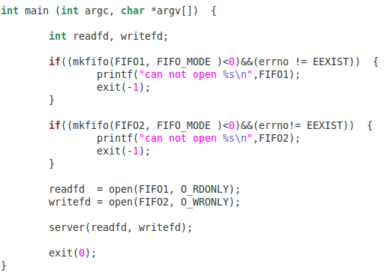
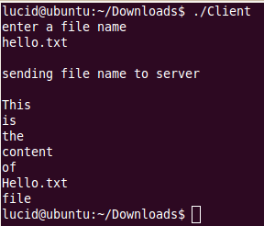

FIFO example
Ex_2_client.c
Ex_2_server.c
Example: https://www.geeksforgeeks.org/named-pipe-fifo-example-c-
program/

Slide 20

Signals
Definition
Signal Types
Generating Signals
Responding to a Signal
POSIX Signal Functions
Signals & System Calls

Slide 21
Definition
A signal is an asynchronous event which is delivered to a process
Asynchronous means that the event can occur at any time
  may be unrelated to the execution of the process
  e.g. user types ctrl-C, or the modem hangs

Slide 22
Common use of Signals
Ignore a Signal
Clean up and Terminate
Dynamic Reconfiguration
Report Status
Turn Debugging on/off
Restore Previous Handler
Signals & System Calls

Slide 23
Generating a Signal
#include <sys/types.h> #include <signal.h>
int kill (pid_t pid, int sig);
Sends a signal to a process or a group of processes
Return 0 if ok, -1 on error
Use the Unix command
  $> kill -KILL 4481
  Sends a SIGKILL signal to pid 4481
ps -l
  To make sure process died

Slide 24
PID Options
If pid is positive, then signal sig is sent to the process with the ID specified by pid.
If pid equals 0, then sig is sent to every process in the process group of the calling process.
If pid equals -1, then sig is sent to every process for which the calling process has permission to send signals, except for process 1 (init), but see below.
If pid is less than -1, then sig is sent to every process in the process group whose ID is -pid.
If sig is 0, then no signal is sent, but error checking is still performed; this can be used to check for the existence of a process ID or process group ID

Slide 25
Responding to a Signal
A process can;
  Ignore/discard the signal (not possible for SIGKILL & SIGSTOP)
  Execute a signal handler function, and then possibly resume execution or terminate
  Carry out default action for that signal
The choice is called the process’ signal disposition

Slide 26
POSIX Signal System
The POSIX signal system, uses signal sets, to deal with pending signals that might otherwise be missed while a signal is being processed
The signal set stores collection of signal types
Sets are used by signal functions to define which signal types are to be processed
POSIX contains several functions for creating, changing and examining signal sets

Slide 27
POSIX Functions
#include <signal.h>
int sigemptyset ( sigset_t *set ); int sigfillset ( sigset_t *set );
int sigismember ( const sigset_t *set,int signo ); int sigaddset ( sigset_t *set, int signo );
int sigdelset ( sigset_t *set, int signo );
int sigprocmask ( int how, const sigset_t *set, sigset_t *oldset);

Slide 28
sigaction()
Supercedes (more powerful than) signal()
  can be used to code a non-resetting signal()
#include <signal.h>
int sigaction (int signo, const struct sigaction *act, struct sigaction *oldact )

Slide 29
sigaction Structure
struct sigaction {
void (*sa_handler)( int ); //action to be taken or SIG_IGN, SIG_DFL
sigset_t sa_mask; int sa_flags;
//additional signal to be blocked
// modifies action of the signal
void (*sa_sigaction)( int, siginfo_t *, void * );
}
sa_flag
SIG_DFL reset handler to default upon return
SA_SIGINFO denotes extra information is passed to handler (.i.e. specifies the use of the “second” handler in the structure.

Slide 30
sigaction() Behavior
A signo signal causes the sa_handlersignal handler to be called.
While sa_handler executes, the signals in sa_mask are blocked. Any more signo signals are also blocked.
sa_handler remains installed until it is changed by another sigaction()call. No reset problem

Slide 31
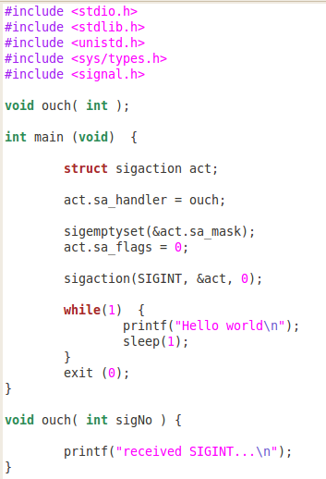
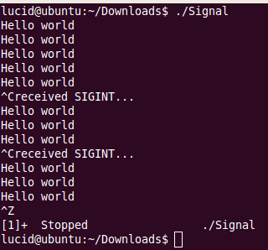

A Simple Example !!!
Ex_3_signal1.c

Slide 32
Ignoring Signals
Other than SIGKILL and SIGSTOP, signals can be ignored.
Instead of in the previous program: act.sa_handler = catchint /* or whatever */ We use :
act.sa_handler = SIG_IGN;
The ^C key will be ignored

Slide 33
Restoring Previous Action
The third parameter to sigaction, oact, can be used:
/* save old action */
sigaction( SIGTERM, NULL, &oact);
/* set new action */ act.sa_handler = SIG_IGN; sigaction( SIGTERM, &act, NULL );
/* restore old action */ sigaction( SIGTERM, &oact, NULL );

Slide 34
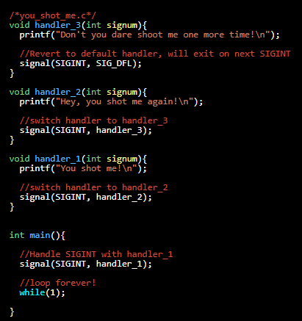

Changing and Reverting to the
r
default handle
https://www.usna.edu/Users/cs/aviv/classes/ic221/s17/units/06/ unit.html

Slide 35
Message Queues
Unlike pipes and FIFOs, message queues support messages that have
structure.
Like FIFOs, message queues are persistent objects that must be initially created and eventually deleted when no longer required.
Message queues are created with a specified maximum message size and maximum number of messages.
Message queues are created and opened using a special version of the open system call, mq_open.
Notes:
Used in producer–consumer cases
Kernel-buffered (unlike pipes)
Can carry structured messages (metadata + payload)

Slide 36
POSIX Message Queue Functions
mq_open()
mq_close()
mq_unlink()
mq_send()
mq_receive()
mq_setattr()
mq_getattr()
mq_notify()

Slide 37
mq_open(const char *name, int oflag,...)
name
  Must start with a slash and contain no other slashes
  QNX puts these in the /dev/mqueue directory
oflag
  O_CREAT – to create a new message queue
  O_EXCL – causes creation to fail if queue exists
  O_NONBLOCK – usual interpretation
mode – usual interpretation
&mqattr – address of structure used during creation

Slide 38
mq_attr structure
This structure, pointed to by the last argument of mq_open, has at least the following members:
  mq_maxmsg – maximum number of messages that may be stored in the message queue
  mq_msgsize – the size of each message, in bytes
  mq_flags – not used by mq_open, but accessed by mq_getattr and mq_setattr
  mq_curmsgs – number of messages in the queue

Slide 39
mq_close(mqd_t mqdes)
This function is used to close a message queue after it has been used.
As noted earlier, the message queue is not deleted by this call; it is persistent.
The message queue’s contents are not altered by mq_close unless a prior call(by this or another process) called mq_unlink (see next slide). In this respect, an open message queue is just like an open file: deletion is deferred until all open instances are closed.

Slide 40
mq_unlink(const char *name)
This call is used to remove a message queue.
Recall (from the previous slide) that the deletion is deferred until all processes that have the message queue open have closed it (or terminated).
It is usually a good practice to call mq_unlink immediately after all processes that wish to communicate using the message queue have opened it. In this way, as soon as the last process terminates (closing the message queue), the queue itself is deleted.

Slide 41
Message Queue Persistence - I
As noted, a message queue is persistent.
Unlike a FIFO, however, the contents of a message queue are also persistent.
It is not necessary for a reader and a writer to have the message queue open at the same time. A writer can open (or create) a queue and write messages to it, then close it and terminate.
Later a reader can open the queue and read the messages.

Slide 42
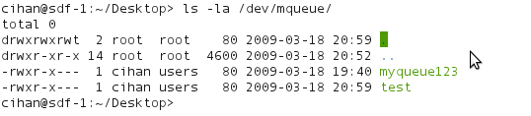
Message Queue Persistence - II
mkdir /dev/mqueue
mount -t mqueue none /dev/mqueue
ls -la /dev/mqueue

Slide 43
mq_send(mqd_t mqdes, const char *msq_ptr, size_t msglen, unsigned msg_prio)
mqdes
  the descriptor required by mq_open
msg_ptr
  pointer to a char array containing the message
msglen
  number of bytes in the message; this must be no larger than the maximum message size for the queue
prio
  the message priority (0..MQ_PRIO_MAX); messages with larger (higher) priority leap ahead of messages with lower (smaller) priority

Slide 44
mq_receive(mqd_t mqdes, char *msq_ptr, size_t msglen, unsigned *msg_prio)
mqdes
  the descriptor returned by mq_open
msg_ptr
  pointer to a char array to receive the message
msglen
  number of bytes in the msg buffer; this should normally be equal to the maximum message size specified when the message queue was created
msg_prio
  pointer to a variable that will receive the message’s priority
The call returns the size of the message, or -1

Slide 45
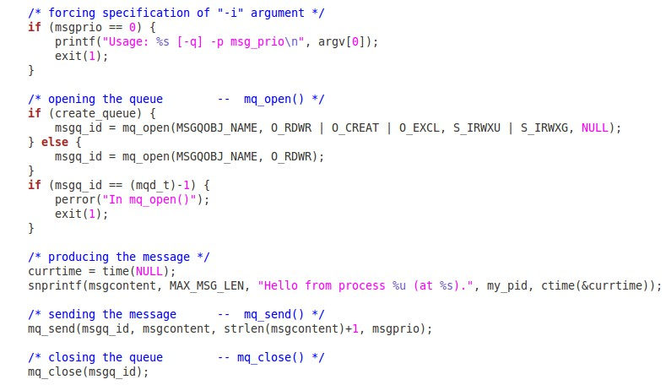
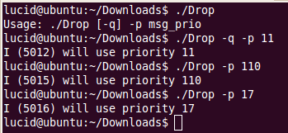
A simple Message Queue Example Sender
Ex_5_mq_dropone.c

Slide 46
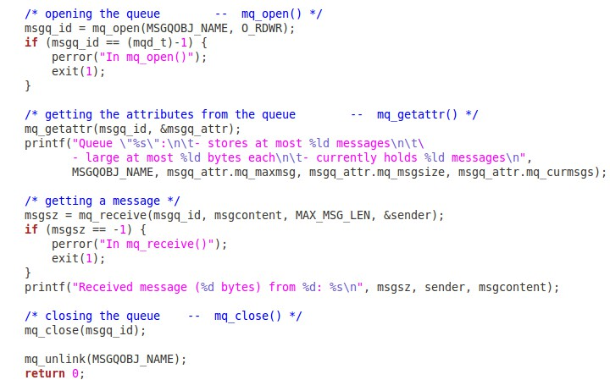
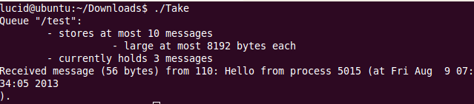
A simple Message Queue Example Receiver
Ex_5_mq_takeone
.c

Slide 47
The effect of fork on a message queue
Message queue descriptors are not (in general) treated as file descriptors; the unique open, close, and unlink calls should already suggest this.
Open message queue descriptors are not inherited by child processes created by fork.
Instead, a child process must explicitly open (using mq_open) the message queue itself to obtain a message queue descriptor

Slide 48
Detecting non-empty queues
mq_receive on an empty queue normally causes a process to block, and this may not be desirable.
Of course, O_NONBLOCK could be applied to the queue to prevent this behavior, but in that case the mq_receive call will return -1, and our only recourse is to try mq_receive again later.
With the mq_notify call we can associate a single process with a message queue so that it (the process) will be notified when the message queue changes state from empty to non-empty

Slide 49
mq_notify(mqd_t mqdes, const struct sigevent *notification)
queuefd
  as usual, to identify the message queue
sigev
  a struct sigevent object that identifies the signal to be sent to the process to notify it of the queue state change.
Once notification has been sent, the notification mechanism is removed. That is, to be notified of the next state change (from empty to non-empty), the notification must be reasserted.

Slide 50
Changing the process to be notified
Only one process can be registered (at a time) to receive notification when a message is added to a previously-empty queue.
If you wish to change the process that is to be notified, you must remove the notification from the process which is currently associated (call mq_notify with NULL for the sigev argument), and then associate the notification with a different process.

Slide 51
Attributes
mq_getattr (queuefd,&mqstat)
  retrieves the set of attributes for a message queue to the struct mq_attr object named mqstat.
  the mq_flags member of the attributes is not significant during mq_open, but it can be set later
mq_setattr (queuefd,&mqstat,&old)
  Set (or clear) to O_NONBLOCK flag in the mqattr structure for the identified
message queue
  Retrieve (if old is not NULL) the previously existing message queue attributes
  Making changes to any other members of the mqattr structure is ineffective.

Slide 52
Timed send and receive
Two additional functions, mq_timedsend and mq_timedreceive, are like mq_send and mq_receive except they have an additional argument, a pointer to a struct timespec.
This provides the absolute time at which the send or receive will be aborted if it cannot be completed (because the queue is full or empty, respectively).

Slide 53
Shared Memory
Sharing memory in POSIX (and many other systems) requires
creating a persistent “object” associated with the shared
allowing processes to connect to the object.
creating or connecting to the persistent object is done in a manner similar to that for a file, but uses the shm_open system call.
memory, and
Notes:
Shared Memory Message Passing
Fast, direct access Simpler, safer
Synchronization required Less risk of race conditions
Used by databases, in-memory caches Used by microservices, pipelines
Fastest IPC
Processes attach same region
Requires locking → semaphores/mutex
Real world:
Databases
High-performance trading systems

Slide 54
Shared Memory Functions
shm_open()
mmap()
munmap()
ftruncate()
shm_unlink()

Slide 55
shm_open (name, oflag, mode)
name is a string identifying an existing shared memory object or a
new one (to be created). It should begin with ‘/’, and contain only one
slash. In QNX 6, these objects will appear in a special directory.
mode is the protection mode (e.g. 0644).
shm_open returns a file descriptor, or –1 in case of error

Slide 56
shm_open (name, oflag, mode)
oflag is similar to the flags for files:
  O_RDONLY – read only
  O_RDWR – read/write
  O_CREAT – create a new object if necessary
  O_EXCL – fail if O_CREAT and object exists
  O_TRUNC – truncate to zero length if opened R/W

Slide 57
ftruncate(int fd, off_t len)
This function (inappropriately named) causes the file referenced by fd to have the size specified by len.
If the file was previously longer than len bytes, the excess is discarded.
If the file was previously shorter than len bytes, it is extended by bytes containing zero.

Slide 58
mmap (void *addr, size_t len, int prot, int flags, int fd, off_t off);
mmap is used to map a region of the shared memory object (fd) to
the process’ address space.
The mapped region has the given len starting at the specified offset off.
Normally addr is 0, and allows the OS to decide where to map the region. This can be explicitly specified, if necessary.
mmap returns the mapped address, or –1 on error.(more on next slide)

Slide 59
mmap, continued
prot – selected from the available protection settings:
  PROT_EXEC
  PROT_NOCACHE
  PROT_NONE
  PROT_READ
  PROT_WRITE
flags – one or more of the following:
  MAP_FIXED – interpret addr parameter exactly
  MAX_PRIVATE – don’t share changes to object
  MAP_SHARED – share changes to object

Slide 60
munmap (void *addr, size_t len)
This function removes mappings from the specified address range.
This is not a frequently-used function, as most processes will map a fixed-sized region and use shm_unlink at the end of execution to destroy the shared memory object (which effectively removes the mappings).

Slide 61
shm_unlink (char *name);
This function, much like a regular unlink system call, removes a reference to the shared memory object.
If the are other outstanding links to the object, the object itself continues to exist.
If the current link is the last link, then the object is deleted as a result of this call.

Slide 62
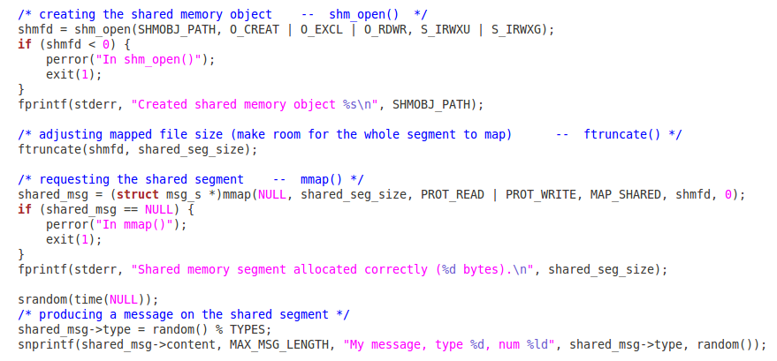

A Simple Shared Memory Example Sender
Ex_6_shm_server.c

Slide 63
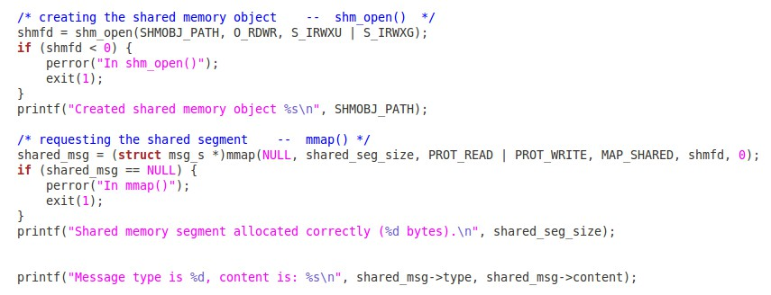

A Simple Shared Memory Example Receiver
Ex_6_shm_client.c

Slide 64
Which of the following is a fundamental requirement for any IPC mechanism to function correctly?
A) Both processes must use the same programming language
B) The kernel must provide a way to reference and access shared resources
C) Processes must be owned by the same user
D) Both processes must share their stack memory
Notes:
B

Slide 65
What does it mean for a process to be independent in the context of IPC?
A) It does not share data with any other process
B) It runs without being scheduled by the kernel
C) It communicates only through sockets
D) It can modify another process’s memory directly
Notes:
A
or coordinate with any other process

Slide 66
When two processes exchange information without knowing each other’s identity, what form of communication are they using?
A) Direct communication
B) Blocking communication
C) Indirect communication
D) Symmetric communication
Notes:
C

Slide 67
Which of the following best describes synchronous (blocking) communication?
A) A process sends a message and continues without waiting
B) A message is guaranteed to be delivered even if the receiver is offline
C) A send or receive operation may pause until the other party participates
D) All messages require a return acknowledgement packet
Notes:
C

Slide 68
A communication model where the sender and receiver must both be ready at the same time is called:
A) Asynchronous buffering
B) Direct addressing
C) Rendezvous communication
D) Indirect messaging
Notes:
C

Slide 69
Which of the following is TRUE about unnamed pipes in Unix/POSIX?
A. They support bidirectional communication by default
B. They are created using mkfifo()
C. They only exist as the processes using them exist
D. They require a filesystem path to access
Notes:
C

Slide 70
When a process writes to a pipe but the pipe’s buffer is full, what typically happens?
A. Data is dropped
B. Writer blocks until buffer has space
C. Reader is forced to read immediately
D. Pipe automatically expands
Notes:
B

Slide 71
Which statement about named pipes (FIFOs) is FALSE?
A. They are represented as special files in the filesystem
B. They persist after all processes close them
C. Multiple unrelated processes can communicate through them
D. They guarantee message boundaries
Notes:
D
(FIFOs are stream-based — no message boundaries.)

Slide 72
What happens if a process attempts to open a FIFO for reading while no writer has it open?
A. The FIFO is deleted automatically
B. open() blocks until a writer appears
C. open() fails with EINVAL
D. FIFO is opened, but reads return 0 immediately
Notes:
B

Slide 73
Which is an advantage of FIFOs over unnamed pipes?
A. Faster due to filesystem caching
B. No blocking behavior
C. Support between unrelated processes
D. Support for message boundaries
Notes:
C

Slide 74
Unlike pipes and FIFOs, message queues primarily provide:
A. Bi-directional communication by default
B. Ordered, message-bounded data transfer
C. Shared memory segments for faster access
D. Non-blocking read and write only
Notes:
B

Slide 75
What happens when a message larger than the queue’s maximum message size is sent?
A. It is automatically fragmented
B. The queue grows dynamically
C. The call fails and sets EINVAL
D. The kernel truncates the message
Notes:
C

Slide 76
In POSIX message queues, the name of the queue:
A. Must start with a /
B. Must match a permission mode
C. Can be any path in the filesystem
D. Is optional — unnamed queues are allowed
Notes:
A

Slide 77
What happens if a process calls mq_close() on a POSIX queue but does NOT call mq_unlink()?
A. The queue is destroyed immediately
B. The queue persists until all messages are read
C. The queue persists until the system reboots
D. Messages are deleted, but the queue stays open
Notes:
C
or someone calls mq_unlink()

Slide 78
mqd_t q = mq_open("/q7", O_CREAT | O_RDWR, 0644, NULL);
mq_unlink("/q7");
mq_send(q, "X", 2, 0);
mq_close(q);
What happens if this code runs?
A. Send succeeds because unlink removes name, not descriptor
B. Send succeeds unless queue was empty
C. Send fails because queue is unlinked
D. Undefined behavior
Notes:
A

Slide 79
After calling shm_open(), which operation is typically required before mmap()?
A. shm_attach()
B. ftruncate() to set size
C. fork() to share memory with other processes
D. fsync() to initialize the file descriptor
Notes:
B
Shared memory is created with size zero by default

Slide 80
A key advantage of POSIX shared memory compared to pipes and message queues is:
A. It guarantees delivery order
B. It allows direct load/store access
C. It automatically synchronizes processes
D. It only exists while processes are running
Notes:
B
With no Data copy overhead

Slide 81
Which best describes the lifetime of a POSIX shared memory object?
A. It disappears when the creating process exits
B. It persists until all data is overwritten
C. It persists until explicitly removed
D. It is deleted automatically after being closed
Notes:
C
with shm_unlink()

Slide 82
What happens if a shared memory object is unlinked while processes are still using it?
A. New processes cannot open it, but existing mappings works
B. All processes immediately lose access
C. The kernel deletes the object instantly
D. The system re-creates it automatically upon close, and renews the links
Notes:
A

Slide 83
Which scenario BEST demonstrates when POSIX shared memory is the ideal IPC choice?
A. Sending small control messages between processes
B. Logging text from one app to another
C. Temporary synchronization across the network
D. High-volume or high-speed data sharing
Notes:
D
between many processes

Slide 84
int fd = shm_open("/test", O_CREAT | O_RDWR, 0666);
ftruncate(fd, 1); // only 1 byte
char *ptr = mmap(NULL, 4096, PROT_READ | PROT_WRITE, MAP_SHARED,
fd, 0);
ptr[2] = 'A’;
What happens?
A. Write succeeds normally
B. Undefined behavior
C. ptr becomes read-only
D. OS silently resizes shared memory
Notes:
B
— writing past ftruncate size

